Slide 1
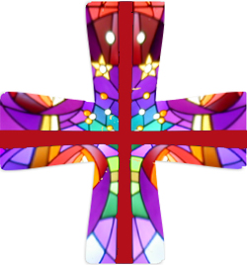
Second Week of Advent
Emmanuel means “God with us”. God is always with us, just like he was with the
Israelites who wandered through
the desert. We sometimes
forget that God is with us,
too, even though he promised
that he is. We don’t have to see
Baby Jesus in front of us to celebrate his presence.
https://www.youtu

Slide 2
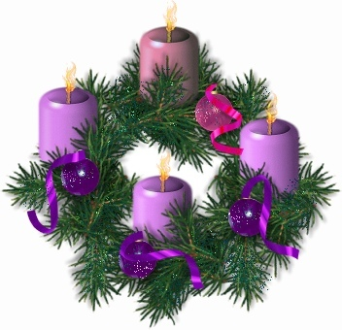
Emmanuel means “God with us”. God is
always with us, just like he was with the
Israelites who wandered through
the desert. We sometimes
forget that God is with us,
too, even though he promised
that he is. We don’t have to see
Baby Jesus in front of us to celebrate
his presence.

Slide 3
Opening Prayer
Reader: Let us begin with the sign of our faith.
All: In the name of the Father, and of the Son and of the
Holy Spirit. Amen.
Reader: God of timeless grace, you fill us with joyful expectation. Make us ready for the message that prepares the way
that with uprightness of heart and holy joy we may eagerly await the kingdom of your Son, Jesus Christ, who reigns with you and the Holy Spirit, now and for ever.
Amen.

Slide 4
Lighting of Advent Candles

Slide 5
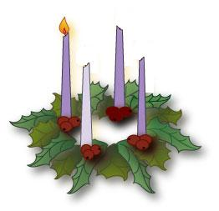
Light the Advent Candle
Light the Advent candle one.
Sign of faith in Christ the Son;
Christ will come again one Day
Time to think, and watch and pray.
Notes:
Song is to be sung with live accompaniment or played on CD.

Slide 6
CHORUS:
Candle, candle burning bright, shining in the cold winter night Candle, candle burning bright Fill our hearts with Christmas light.

Slide 7
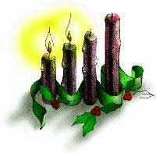
Light the Advent candle two Sign of love for me and you.
Christ will come on clouds of light,
So we wait this wondrous sight.

Slide 8
CHORUS:
Candle, candle burning bright, shining in the cold winter night Candle, candle burning bright Fill our hearts with Christmas light.

Slide 9
Reader: A reading from the book of the Prophet Isaiah
People of Jerusalem, you don’t need to cry anymore.
The Lord is kind, and as soon as he hears you crying,
He will come to help you.
He will send rain to water the seeds you have planted,
and your fields will produce more crops than you need.
When that time comes, your cattle will graze in open pastures.
Even the oxen and donkeys that plow your fields
Will be fed grain that has been prepared in a special way.
And it will be placed there for them with shovels and pitchforks.

Slide 10
On the day the Lord binds up his people’s injuries
And heals the wounds he has caused,
The moon will be bright as the sun.
The light of the sun will be seven times brighter than usual,
And it will be like the light of seven days all at once.
The word of the Lord
ALL: Thanks be to God.

Slide 11
A reading from the holy gospel according to Matthew.
ALL: Glory to you O Lord.
Jesus went to every town and village.
He taught in their meeting places and preached the good
news about God’s kingdom.
Jesus also healed every kind of disease and sickness.
When he saw the crowds, he felt sorry for them.
They were confused and helpless, like sheep without a shepherd.
He said to his disciples, “A large crop is in the fields, but there are
only a few workers. Ask the Lord in charge of the harvest
to send out workers to bring it in.”

Slide 12
Jesus called together his twelve disciples.
He gave them the power to force out evil spirits
and to heal every kind of disease and sickness.
Jesus sent out the twelve apostles with these instructions:
“Go only to the people of Israel, because they are like a flock
of lost sheep.
“As you go, announce that the kingdom of heaven will soon
be here.”
The gospel of the Lord.
ALL: Praise to you Lord Jesus Christ

Slide 13
Reader: The response is O Come, O Come Emmanuel
All: O Come, O Come, Emmanuel
Reader: We pray for all who are suffering today, that the season of Advent bring them peace. R
All: O Come, O Come, Emmanuel
Reader: We pray for all who are hungry, that they receive what they need in this season of giving. R
All: O Come, O Come, Emmanuel
Reader: We pray for all in our St Marguerite Bourgeoys community, that they may rejoice in this time of hope. R
All: O Come, O Come, Emmanuel

Slide 14
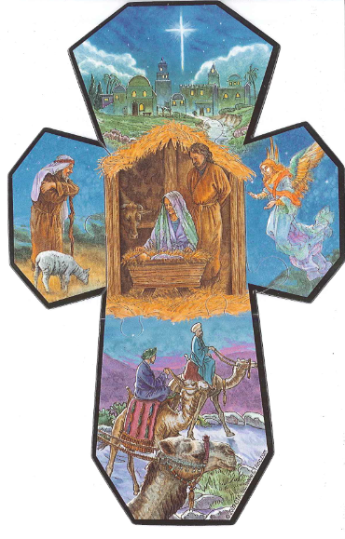
Closing Prayer
Presider: May Jesus Christ, coming in glory,
bring hope and joy to all.
All: Amen.

Slide 15
Thank you to the following students from Ms Markotich’s class:
Jillian Rand
Peter Rigos
Owen Wallace
Curtis Rizzo
Luke Shepherd

